Slide 1
Springboard Capstone 2
Abdul Hannan
06/22
Personal Key Indicators of Heart Disease

Slide 2
Introduction
Behavioral Risk Factor Surveillance System.
Risk factors of heart disease - blood pressure, cholesterol, smoking.
Original dataset contained nearly 300 variables and the version acquired from Kaggle had 20 of the 300 variables.
Unbalanced classes.

Slide 3
Data Wrangling
14 Categorical Variables & 4 Numerical variables.
319,795 entries with no missing data.
The Race variable is imbalanced with about 76% entries that classify as white (the most), while American Indian/Alaskan Native with only 0.15% population quota (the least) with the highest rate of heart disease (0.1), second was White.

Slide 4

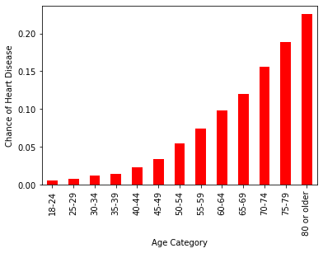
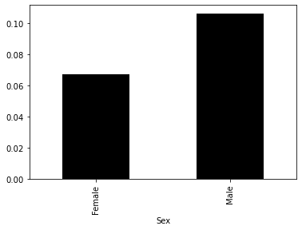
Exploratory Data Analysis
Older Patients are at more risk of a heart disease.
Male Patients are at more risk of a heart disease.
Smoking doubles the chances of you contracting a heart disease.
Diabetic, Strokes, skin cancer, kidney disease, poor lifestyle significantly increase the risk of a heart disease.
No exercising – Difficulty walking – can increase your chances by 4X.

Slide 5
Pre Processing and Training
After getting dummies at the end of EDA, we saved the dummy data and applied the train test split with 75% data for training set.
The imbalance of our target variable corroborates with the imbalance in our train and test sets.
Since in our problem, the opportunity cost on passing up on a client is high, and the cost of acting is low, thus we will use recall to compare model scores.
Basic Logistic regression on the imbalanced classes reveals a whopping recall score of 0.10 for our target class (Heart Disease – Yes (1)).

Slide 6
Modeling
To target imbalance, we resampled the data three different ways, ADASYN, SMOTE, and RUS (RandomUnderSampler).
We built three classifier with each sampling method, XGBoost with RUS performed the best.
Decreased the threshold for picking classes to 0.4, for a better recall score, 0.90.

Slide 7
Recommendations
Apply SHAP values that represent a forward approach to interpret predictions, BMI, age, etc.
Distinguish the characteristics that lead to a wrong outcome.
Further collection of patients medical history can be beneficial to the current model.

